Slide 1
CSCIU 210 Computer Organization AKM Jahangir A Majumder, PhD
Fall 2018 - Lecture 4
August 31, 2018
Note: Some slides are adapted from those used by previous instructors and some slides include figures from the textbook.

Slide 2
Review and Learning Outcomes
We discussed Computer performance.
Will continue to cover computer performance today
Will learn:
Integrated Circuit (IC) Cost
Logic gates and expression
Homework #1 is posted on blackboard, which will due on Wednesday, Sept. 5 at the beginning of the lecture (Hard Copy)
We will have our first Quiz on Friday, Sept. 9, 2018, which will be on Lectures 1, 2, 3 and 4
No class on Monday, Sept. 3, 2018, labor day

Slide 3
Review: Performance Summary
Performance depends on
Algorithm: affects IC, possibly CPI
Programming language: affects IC, CPI
Compiler: affects IC, CPI
Instruction set architecture: affects IC, CPI, T_{c}

Slide 4
Review: Reducing Power
Suppose a new CPU has
85% of capacitive load of old CPU
15% voltage and 15% frequency reduction
The power wall
We can’t reduce voltage further
We can’t remove more heat
How else can we improve performance?

Slide 5
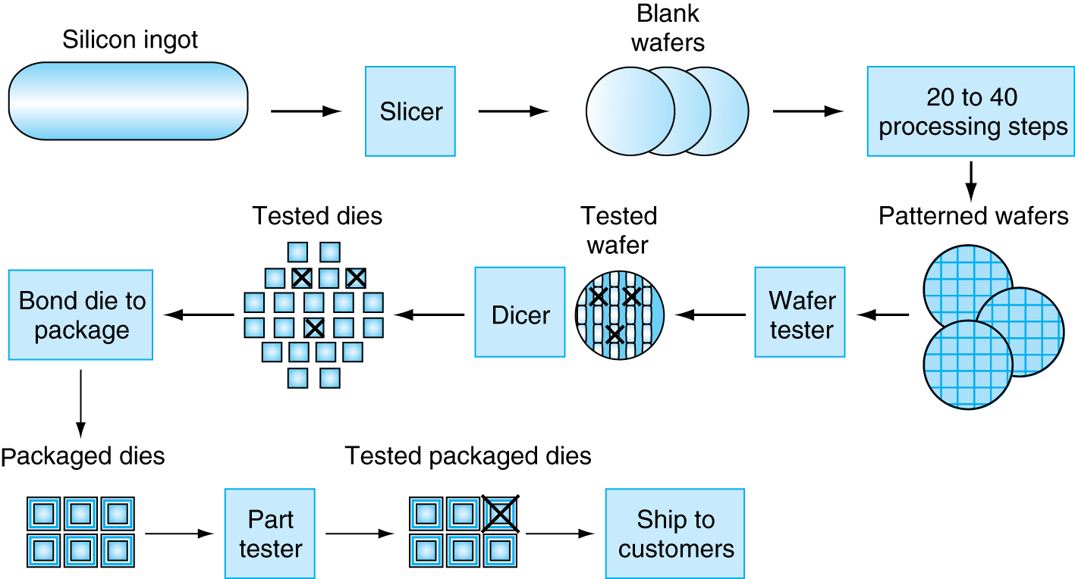
Manufacturing ICs
Yield: proportion of working dies per wafer

Slide 6
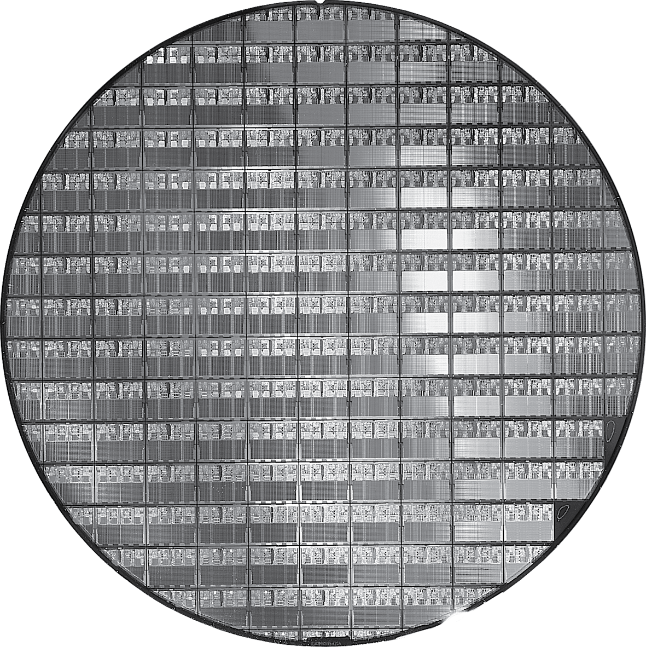
Intel core i7 Wafer
i7: 300mm (12 inch) wafer, 280 chips, 32nm technology
AMD X2: 300nm, 117 chips, 90nm technology
X4: 45nm technology

Slide 7
Integrated Circuit Cost
Nonlinear relation to area and defect rate
Wafer cost and area are fixed
Defect rate determined by manufacturing process
Die area determined by architecture and circuit design

Slide 8
SPEC CPU Benchmark
Programs used to measure performance
Supposedly typical of actual workload
Standard Performance Evaluation Cooperative (SPEC)
Develops benchmarks for CPU, I/O, Web, …
SPEC CPU2006
Elapsed time to execute a selection of programs
Negligible I/O, so focuses on CPU performance
Normalize relative to reference machine
Summarize as geometric mean of performance ratios
CINT2006 (integer) and CFP2006 (floating-point)

Slide 9
CINT2006 for Opteron X4 2356
Name | Description | IC×10⁹ | CPI | Tc (ns) | Exec time | Ref time | SPECratio
perl | Interpreted string processing | 2,118 | 0.75 | 0.40 | 637 | 9,777 | 15.3
bzip2 | Block-sorting compression | 2,389 | 0.85 | 0.40 | 817 | 9,650 | 11.8
gcc | GNU C Compiler | 1,050 | 1.72 | 0.47 | 24 | 8,050 | 11.1
mcf | Combinatorial optimization | 336 | 10.00 | 0.40 | 1,345 | 9,120 | 6.8
go | Go game (AI) | 1,658 | 1.09 | 0.40 | 721 | 10,490 | 14.6
hmmer | Search gene sequence | 2,783 | 0.80 | 0.40 | 890 | 9,330 | 10.5
sjeng | Chess game (AI) | 2,176 | 0.96 | 0.48 | 37 | 12,100 | 14.5
libquantum | Quantum computer simulation | 1,623 | 1.61 | 0.40 | 1,047 | 20,720 | 19.8
h264avc | Video compression | 3,102 | 0.80 | 0.40 | 993 | 22,130 | 22.3
omnetpp | Discrete event simulation | 587 | 2.94 | 0.40 | 690 | 6,250 | 9.1
astar | Games/path finding | 1,082 | 1.79 | 0.40 | 773 | 7,020 | 9.1
xalancbmk | XML parsing | 1,058 | 2.70 | 0.40 | 1,143 | 6,900 | 6.0
Geometric mean |  |  |  |  |  |  | 11.7
High cache miss rates

Slide 10
SPEC Power Benchmark
Power consumption of server at different workload levels
Performance: ssj_ops/sec
Power: Watts (Joules/sec)
Where, ssj_ops_{i} is performance at each 10% increment and power_{i} is power consumed at each performance level.

Slide 11
SPECpower_ssj2008 for X4
Target Load % |  | Performance (ssj_ops/sec) |  | Average Power (Watts)
100% |  | 231,867 |  | 295
90% |  | 211,282 |  | 286
80% |  | 185,803 |  | 275
70% |  | 163,427 |  | 265
60% |  | 140,160 |  | 256
50% |  | 118,324 |  | 246
40% |  | 920,35 |  | 233
30% |  | 70,500 |  | 222
20% |  | 47,126 |  | 206
10% |  | 23,066 |  | 180
0% |  | 0 |  | 141
Overall sum |  | 1,283,590 |  | 2,605
∑ssj_ops/ ∑power |  |  |  | 493

Slide 12
Pitfall: Amdahl’s Law
Improving an aspect of a computer and expecting a proportional improvement in overall performance
Example: multiply accounts for 80s/100s
How much improvement in speed of multiplication performance to get 5× faster overall?
Can’t be done!
Corollary: make the common case fast

Slide 13
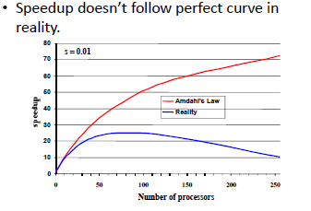
Amdahl’s Law in Reality

Slide 14
Fallacy: Low Power at Idle
Look back at X4 power benchmark
At 100% load: 295W
At 50% load: 246W (83%)
At 10% load: 180W (61%)
Google data center
Mostly operates at 10% – 50% load
At 100% load less than 1% of the time
Consider designing processors to make power proportional to load

Slide 15
Pitfall: MIPS as a Performance Metric
MIPS: Millions of Instructions Per Second
Doesn’t account for
Differences in ISAs between computers
Differences in complexity between instructions
CPI varies between programs on a given CPU

Slide 16
Concluding Remarks
Cost/performance is improving
Due to underlying technology development
Hierarchical layers of abstraction
In both hardware and software
Instruction set architecture
The hardware/software interface
Execution time: the best performance measure
Power is a limiting factor
Use parallelism to improve performance

Slide 17
In Lecture Review
We finished our coverage on Chapter 1
We will have Quiz 1 on Friday, September 7
We will begin our coverage on Digital logic gates and expression now

Slide 18
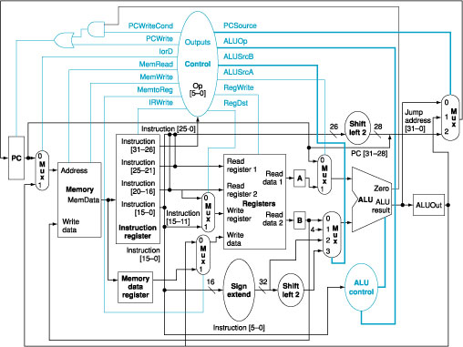
ALU in a MIPS Computer
ALU

Slide 19
Digital Logic
An signal can be defined as an information variable represented by physical quantity.
For digital systems, the variable takes on discrete values.
Two level, or binary values are the most prevalent values in modern computers.
Binary values are represented abstractly by:
digits 0 and 1
words (symbols) False (F) and True (T)
words (symbols) Low (L) and High (H)
and words On and Off.

Slide 20
Signal Example – Physical Quantity: Voltage
OUTPUT
INPUT
5.0
HIGH
HIGH
4.0
3.0
Threshold Region
2.0
1.0
LOW
LOW
0.0
Volts
Notes:
The HIGH range typically corresponds to binary 1 and LOW range to binary 0. The threshold region is a range of voltages
for which the input voltage value cannot be interpreted reliably as either a 0 or a 1.

Slide 21
Combination and Sequential Logic
Digital logic circuit can be classified into the following two categories:
Combinational Logic: logic circuit without memory.
Sequential Logic: logic circuit with memory.
We need both of combinational and sequential circuit to build computer system.
We will cover combinational logic the first.

Slide 22
Basic Logic Gates (Functions)
AND Gate
outputs 1 only if both inputs are 1
OR Gate
outputs 1 if at least one input is 1
NOT Gate
outputs 1 if input is 0 and outputs 0 if input is 1
A
A⋅B
B
A
A+B
B
A
A’

Slide 23
Logic Function Implementation
Switches in parallel => OR
Using Switches
For inputs:
logic 1 is switch closed
logic 0 is switch open
For outputs:
logic 1 is light on
logic 0 is light off.
NOT uses a switch
such that:
logic 1 is switch open
logic 0 is switch closed
Switches in series => AND
Normally-closed switch => NOT
C’

Slide 24
Summary
We finished our coverage on Chapter 1
We began to discuss our coverage on Digital logic gates and expression
We will have Quiz 1 on Friday, September 7

